Slide 1


SignCom
Bridging Communication Gaps with Smart Sign Language Translation and Emotion Analysis
Team Name: SignCom
Team Members:
Darshan B
Varun D
Babith Sarish
Ajay Kumar K
darshanthekingmaker@gmail.com
dvarun2003@gmail.com
babithsarish02@gmail.com
ajaykumarbw21@gmail.com
+91 90870 53509
+91 98942 96618
+91 94864 46388
+91 6381 672747
1

Slide 2

Problem Statement
- Millions of deaf and mute individuals face challenges in communication due to the lack of accessibility to sign language interpretation and emotional cues.
- Existing solutions often lack accuracy, real-time capabilities, or emotional context, hindering effective communication.
Significance:
- Solving this problem can significantly enhance the quality of life for the deaf and mute community, enabling them to communicate more effectively and participate fully in society.
- Bridging communication gaps can foster inclusivity and understanding among individuals with different abilities, leading to a more empathetic and connected society.
2

Slide 3
Proposed Solution
Our solution is an innovative application that leverages advanced technologies to facilitate seamless communication between deaf/mute individuals and others. It involves the use of AI technologies such as ML and NLP to bridge the communication gap between them and others.
Solution Description:
- The application offers real-time sign language to audio conversion and vice versa, along with emotional analysis of the speaker's expressions.
- Through intuitive interfaces and accurate translations, it empowers users to express themselves and understand others more comprehensively.
3

Slide 4
Methodology
- We will employ a combination of machine learning algorithms and computer vision techniques for sign language recognition and emotional analysis.
- Natural language processing (NLP) will be utilized for audio to sign language conversion, ensuring accurate and contextually relevant translations.
Technologies:
Key technologies include deep learning frameworks (e.g., TensorFlow, PyTorch), facial recognition APIs, and NLP libraries (e.g., NLTK, spaCy).
Machine Learning, Computer Vision (OpenCV), Text-to-Speech Synthesis (gTTS, pyttsx3)
Web Development (Django/Flask)
4

Slide 5
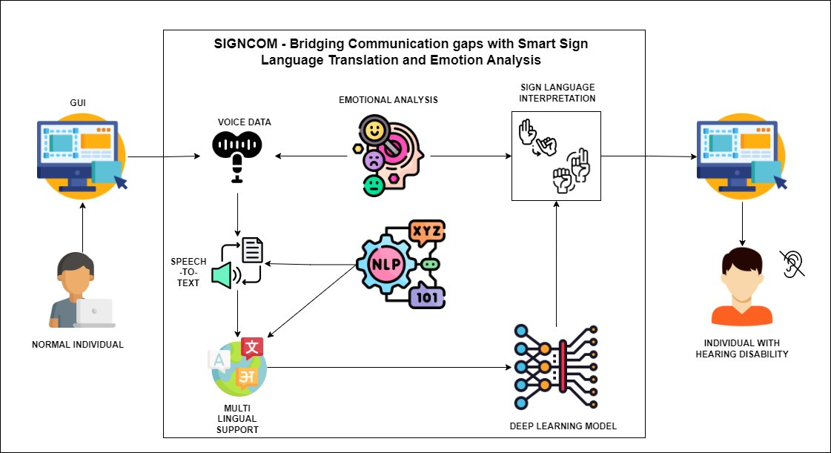
Proposed Model - SignCom
5

Slide 6
Expected Impact
- Our solution aims to break down communication barriers, fostering greater inclusivity and understanding in diverse social settings.
- By providing accessible communication tools, we anticipate improved educational and employment opportunities for the deaf/mute community.
Metrics:
- Success will be measured by
user satisfaction
accuracy of translations
adoption rates
6

Slide 7
Implementation Plan
- Phase 1: Data Collection
- Phase 2: Deep Learning Model Building and NLP Integration
- Phase 4: Emotional Analysis and System Integration
- Phase 3: System Evaluation and Testing
Milestones:
Dataset Collection and Preprocessing
Web Interface Building
Model Selection
Voice-to-Sign Language Interpretation
Sign Language-to-voice Interpretation
Emotional Analysis Integration
System Evaluation and Testing
7

Slide 8
Team Expertise
- Our multidisciplinary team comprises experts in machine learning, computer vision, natural language processing, and user experience design.
- We have a track record of delivering innovative solutions and possess a deep understanding of the challenges faced by the deaf/mute community.
Qualifications:
- Our team members has experience in working projects with Computer Vision, Natural Language Processing and Deep Learning Models.
- Our team members has knowledge about the Web development, Machine Learning, Image Processing, NLP.
- We are committed to making a meaningful impact and have the skills and dedication to execute the proposed solution effectively.
8

Slide 9
Contact Information
Email:
Email: darshanthekingmaker@gmail.com
Phone:
Phone: 9087053509
9

Slide 10
THANK YOU

